Slide 1

Data analysis and visualization of Open data sets

Slide 2
Problem statement
The reason for assigning the tickets by the US government is not to make money but to change the behavior of the traffic violator. Many people are so conscious about the money and when they violate any rule of traffic, they will be worried to pay for the ticket, and they try to avoid getting tickets next time.
By checking the type of violation tickets percentage, we try to decrease the violations count in every violation type.

Slide 3
INTRODUCTION
Parking is a vital component of urban areas. As demand for parking has increased over a certain time with land constraint, parking is becoming a major concern to urban areas. As demand for parking goes on increases, the situation will become worse in the future.
Our concept is to show the various types of violations and their data in the form of percentages that also allows easy visualization of vehicle violation tickets data from dataset. Using a graph, reflecting the predicted tickets through the dataset based on their various types of violated incidents. The browsing interface will help us represent the relation and correspondence between the tickets and number of violations.

Slide 4
COMMERCIAL VEHICLE SPACE REQUIREMENT
PARKING IN NEW YORK CITY
DOUBLE PARKING
ON STREET PARKING AND LOADING
VEHICLE PARKING BEHAVIOR

Slide 5
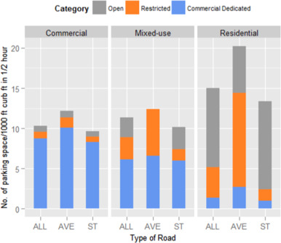
Graph of on street parking data
We analyze the data of all types of areas like Commercial, Mixed-use and Residential areas.
Avenues and Streets and both type of categories of areas are available.

Slide 6
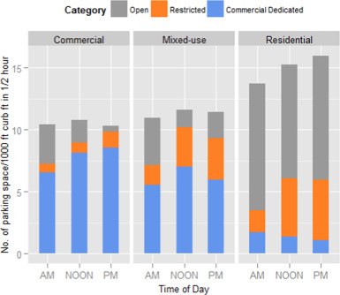
AVAILABLE PARKING SPACE
Here, we analyze the type of available parking spaces between commercial areas, mixed-use area, residential area.
We consider the data of morning from 7AM to 10AM and midday timing from 10AM to 2PM and evening timings from 2PM to 7PM.
We also check the data of Open parking, Restricted parking and Commercial Dedicated parking.

Slide 7
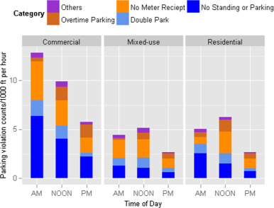
Vehicle PARKING BEHAVIOR
In this graph, we can see the overall parking availabilities from the morning to mid day and from mid day to afternoon.

Slide 8
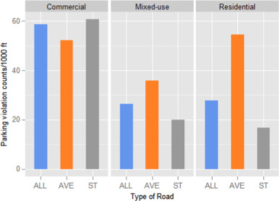
parking area types
Here, we compare between Commercial area type, Mixed-use area type and Residential area type.

Slide 9
PROJECT GOAL
The goal of the project is to get the desired data of traffic violation tickets during some period from the complete dataset. While there is a flexibility of taking certain records from certain period. We collect all the data from all kinds of violation tickets.
We can check for the fine amount for a particular vehicle based on its Plate number. Total number of tickets gives us the idea and using Python tools.
In this python project, arranging the date field is useful as it helps to progress further in our project. We must progress more in pointing out the locations and mapping that location.

Slide 10
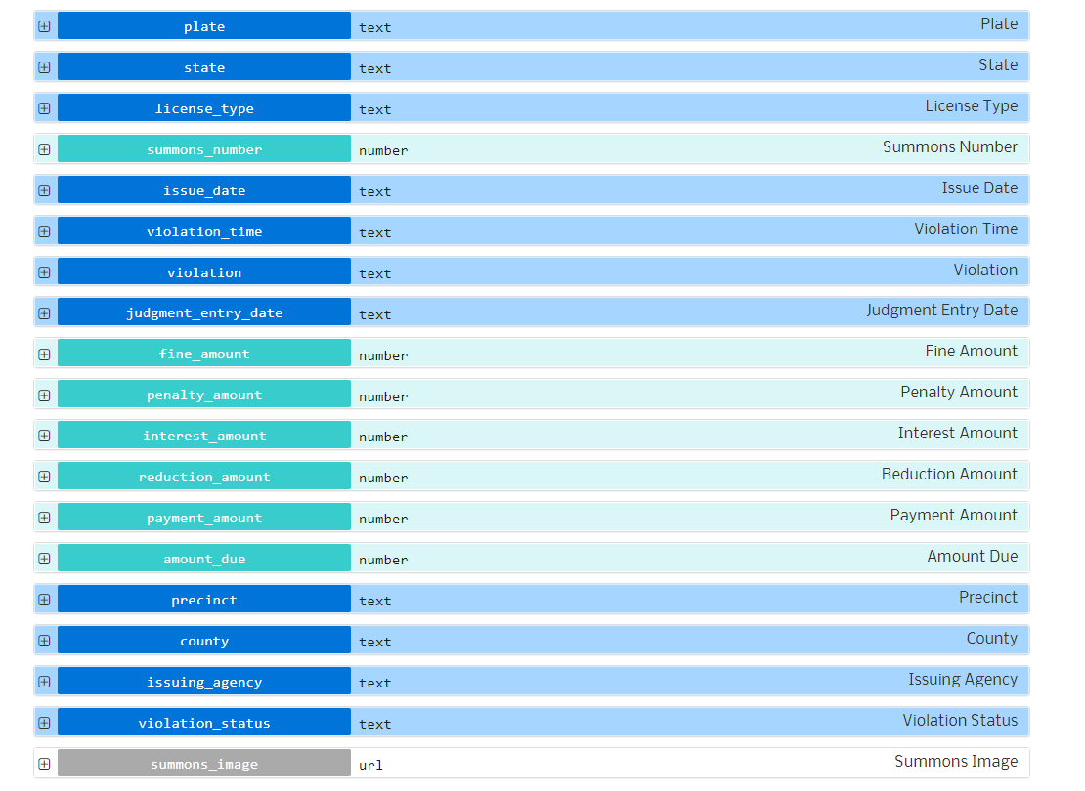
DATASET FIELDS

Slide 11
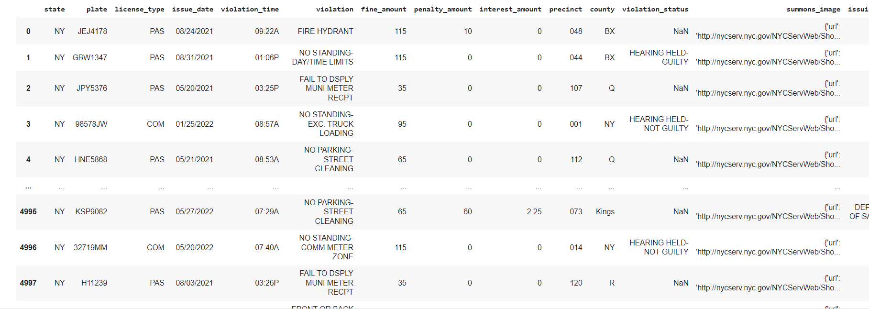
DATASET

Slide 12
PYTHON LIBRARIES
geopandas
Contextily
folium
Matplotlib
mapclassify
Pandas
geopy
sodapy
geoplot
numpy as np
seaborn as sns
opendatasets
Geoviews

Slide 13
UNDERSTANDING THE DATASET
We are considering JSON format data from API and converted into python list of dictionaries by SODAPY. In this project, we are utilizing two python packages pandas and SODAPY. With pandas, the data will be retrieved and put into Pandas data frame. The SODAPY is used to retrieve and analyze data from Socrata open data sources without downloading the data, which will save the time and memory space.

Slide 14
Reading the data
#https://dev.socrata.com/foundry/data.cityofnewyork.us/nc67-uf89
import pandas as pd
from sodapy import Socrata
client = Socrata("data.cityofnewyork.us", None)
# First 5000 results, returned as JSON from API / converted to Python list of
results = client.get("nc67-uf89", limit=5000)
Here, I have considered the whole data frame in pandas. In order to do several tasks in data
analysis, we must consider the data frame in pandas.
print(results_df)

Slide 15
CLEANING THE DATA
Once we import the dataset, we must clean the data by finding the missing values and dropping
the columns which are no longer needed. Here we are filtering the data to get the appropriate data.
Here we are only considering the columns which have complete data. We can then use this copy of
data for our further part of the data analytics project.
cols_to_keep = ['state', 'plate', 'license_type', 'issue_date', 'violation_time’,
'violation', 'fine_amount', 'penalty_amount', 'interest_amount', 'precinct’, ‘county', 'violation_status’,
'summons_image', 'issuing_agency']

Slide 16

MODELING THE DATA
In this Stage, We can give the code based on the required outcome. Suppose we can search for the violations with particular plate or issue date or based on county.
We can also give count variable, which helps in counting the total number of records of the outcomes.

Slide 17
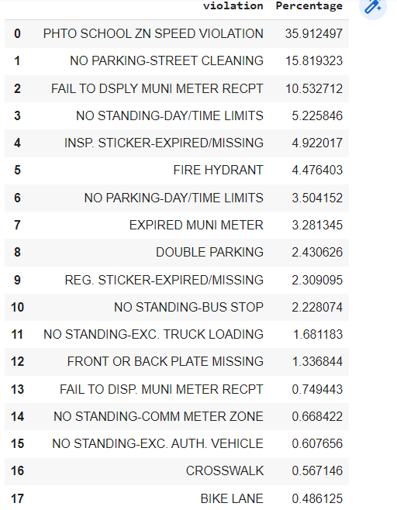
Violations percentage
We can also produce the outputs as

Slide 18
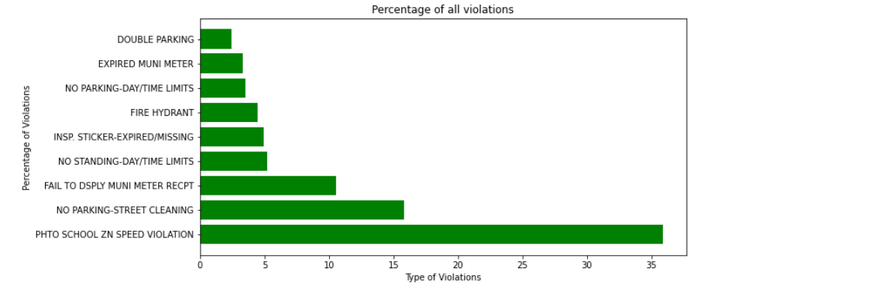
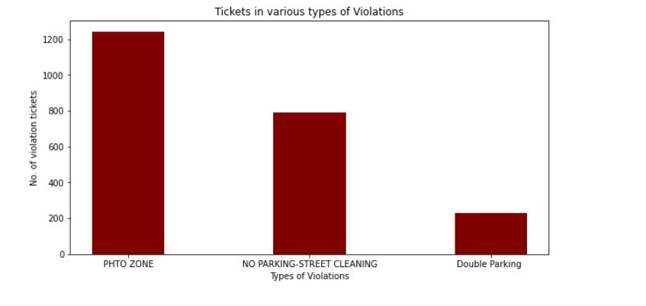
PRESENTATION OF DATA

Slide 19
THANK YOU

